Slide 1
NUCLEAR DATA COVARIANCE ANALYSIS OF AN ENERGY TUNING ASSEMBLY FOR SIMULATING NUCLEAR WEAPON ENVIRONMENTS
Capt Nick Quartemont
MS Nuclear Engineering 19M
Air Force Institute of Technology
25 February 2019

Slide 2


Motivation
2018 Nuclear Posture Review “deterring state support for nuclear terrorism through advanced forensics and attribution capabilities.”
Create accurate surrogate nuclear weapon neutron environment
Addresses deterrence and non-proliferation capability gaps:
Attribution
Certification and testing
Notes:
The 2018 U.S. National Defense Strategy identied the modernization of the nu-
clear triad as a key capability to meet requirements [3]. Therefore, there is still a need
for the capabilities previously provided through nuclear testing for the study of nu-
clear environments to support the credibility of the nuclear deterrent. Previous work
has shown that the loss of nuclear testing has created a capability gap to reproduce
nuclear weapon environments of interest to national security applications including
nuclear weapons effects (NWE) and technical nuclear forensics (TNF).

Slide 3
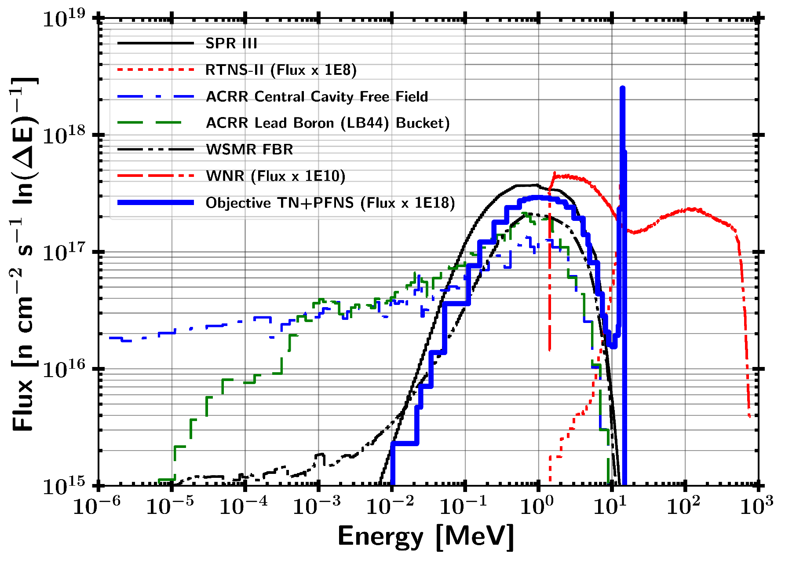
Problem: Capability gap in reproducing nuclear weapon environments
Notes:
A key consideration for testing is the neutron energy spectrum in comparison with the environment that a nuclear weapon would see or produce.
A particular spectrum of interest is the combination of a thermonuclear (TN) and prompt fission neutron spectrum (PFNS) as the present testing does not address this region to a large extent.
The vast majority of testing facilities are focused on the Watt-fission spectrum, while a few are capable of producing the 14.1 MeV TN component from the deuterium-tritium (DT) fusion process\cite{Bridgman}.
The current prompt neutron facilities available are not well suited for the TN+PFNS application testing because of the lack of high energy neutrons, or there is not a large enough flux of neutrons on target.
Several examples of testing facilities for prompt neutrons outlined in Table \ref{tab:NWECap} are the Sandia Pulsed Reactor III (SPR), Sandia Annual Core Research Reactor (ACCR), White Sands Missile Range (WSMR) Fast Burst Reactor (FBR), and the Los Alamos National Laboratory (LANL) Rotating Target Neutron Source (RTNS).
The differential spectral profile of these sources compared to a notional TN+PFNS is shown in Figure \ref{fig:CompSource}. the LANL Weapons Neutron Research facility (WNR).

Slide 4
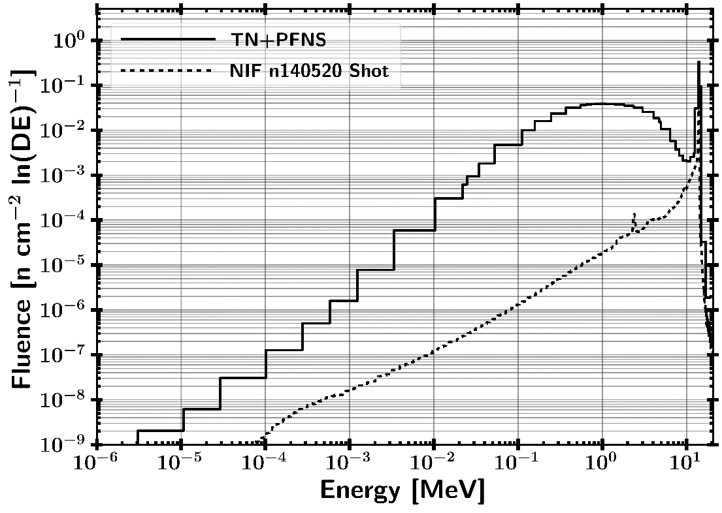
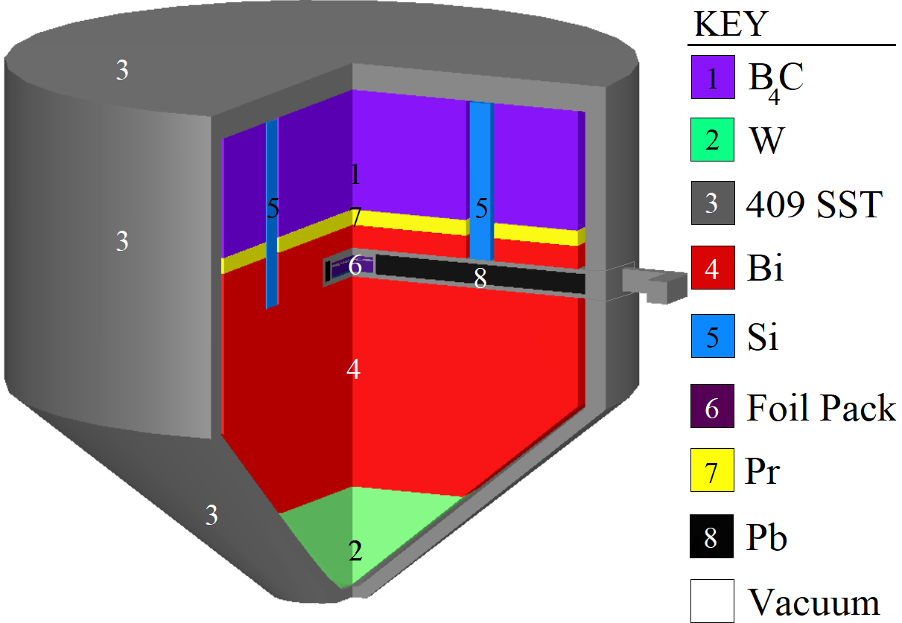
Solution: Energy Tuning Assembly (ETA)
15 cm
ETA Sample Cavity
HEU
Au, Zr, Ni, Al, In, W, Mn
NIF SOURCE

Slide 5
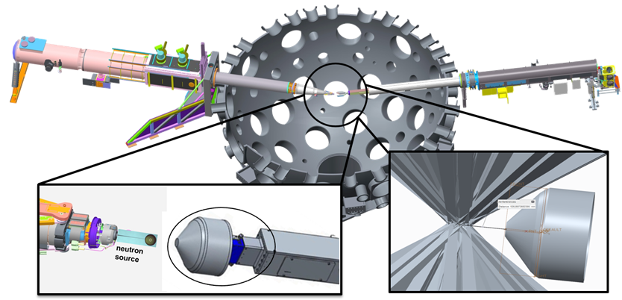
Experimental Overview and Full NIF Model
Modeled Polar Drive Exploding Pusher (PDXP) Deuterium-Tritium neutron source
3.7 x 10¹⁵ 14 MeV neutron yield
Minimal downscatter compared indirect drive methods utilizing a hohlraum
NIF Neutron Source with Mounted ETA Incident Laser Exclusion Zone
Notes:
including the target positioner (TARPOS), Target and Diagnostic Manipulator (TANDM) with ETA and diagnostic snout, polar diagnostic instrument manipulator (DIM), and target chamber with first panel walls

Slide 6
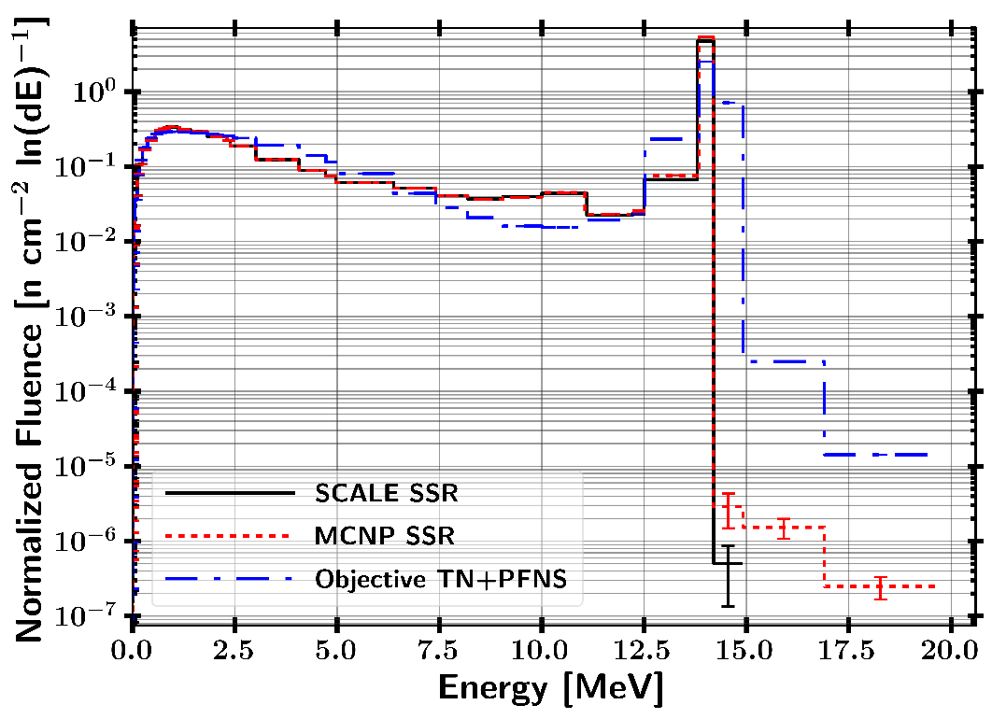
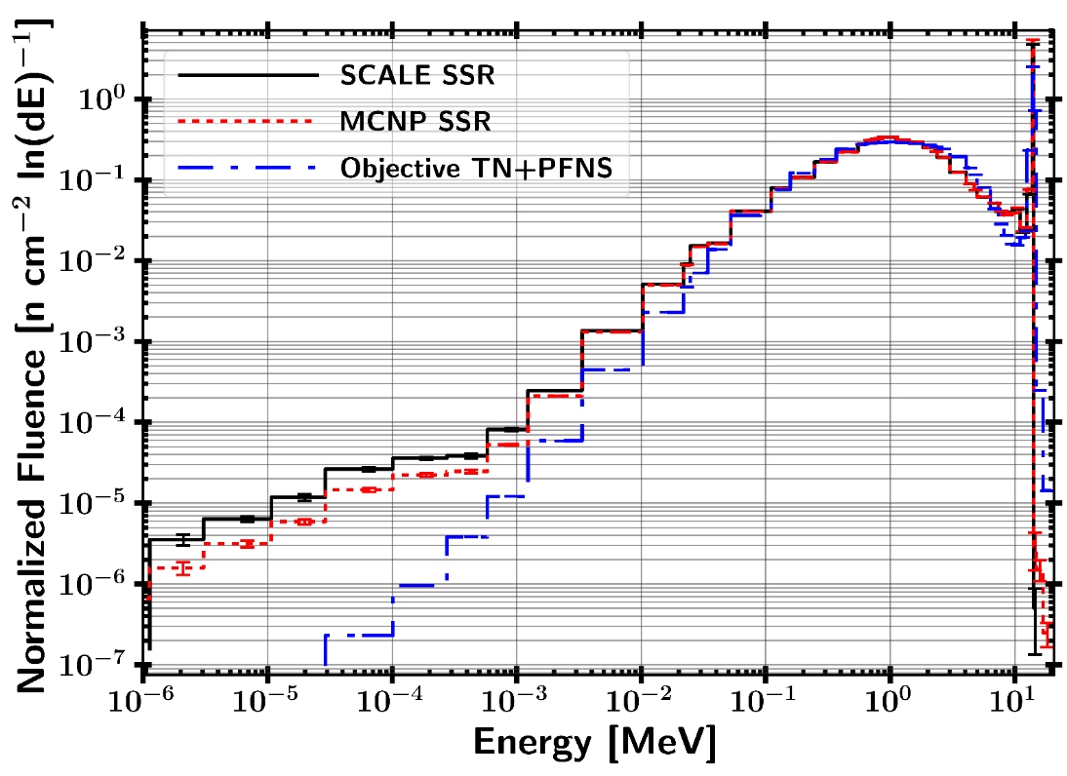
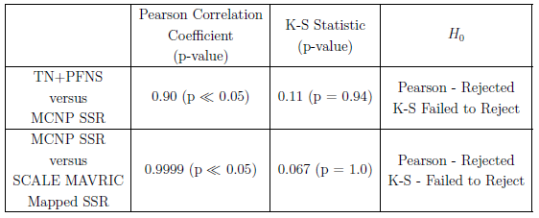
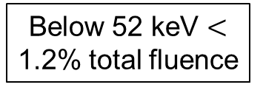
ETA Neutron Energy Distribution Performance
Below 52 keV $<$ 1.2% total fluence
Pearson r
H₀ : no correlation between the datasets
Reject if p-value > 0.05
Kolmogorov-Smirnov (KS) – 2 Sample
H₀ : drawn from the same distribution
Reject if p-value < 0.05

Slide 7
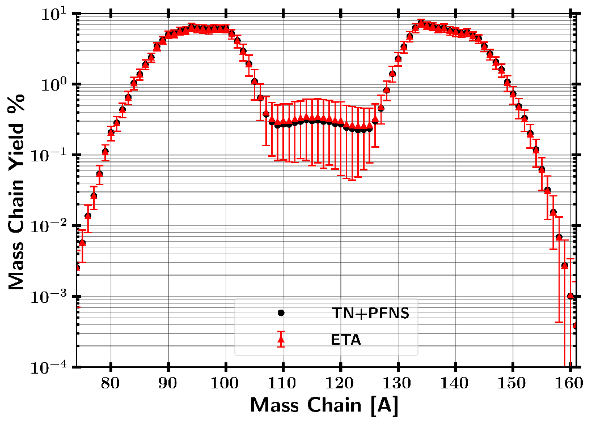
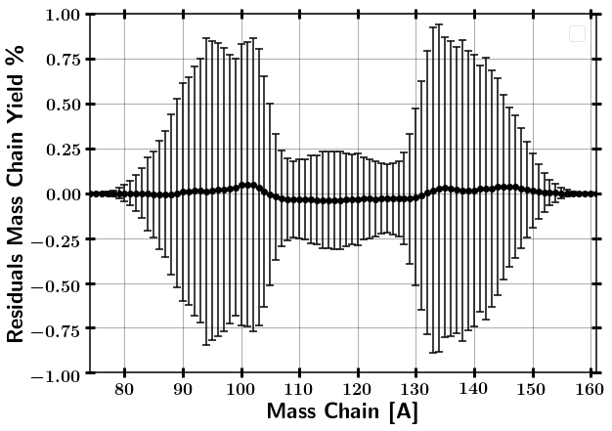
GEF Fission Product Mass Chain Distribution Results
ETA – TN+PFNS Residuals
ETA Produced $2∗{10}^{9}±1\%$ fissions
Modeled ETA produced fission products are consistent to predicted TN+PFNS within error.

Slide 8
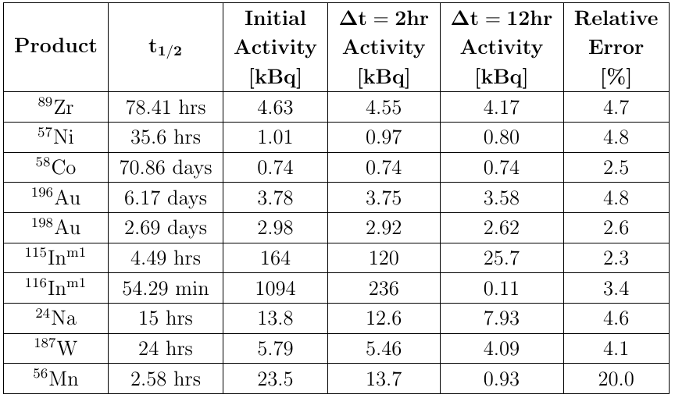
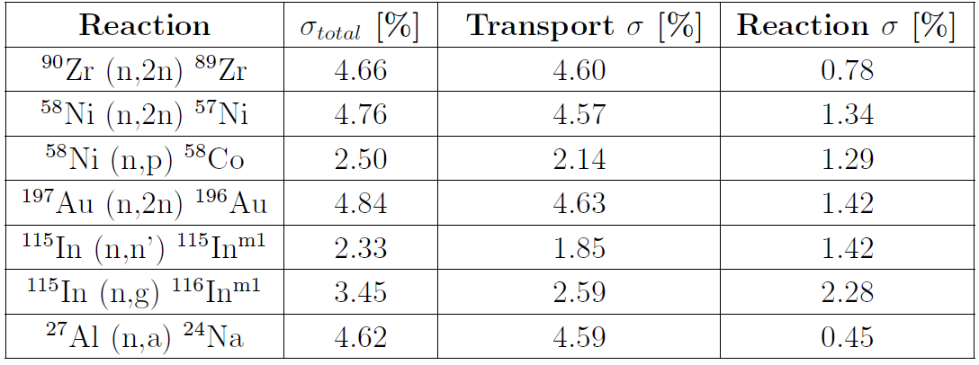

Activation Foil Results
$$R∝σ_{rxn}φ →\frac{σ_{R}}{R}=\sqrt{{\left(\frac{σ_{φ}}{φ}\right)}^{2}+{\left(\frac{σ_{σ_{rxn}}}{σ_{rxn}}\right)}^{2}}$$
All activities are usable for counting statistics.
Main risks are Mn and In reactions which have short half-life.

Slide 9
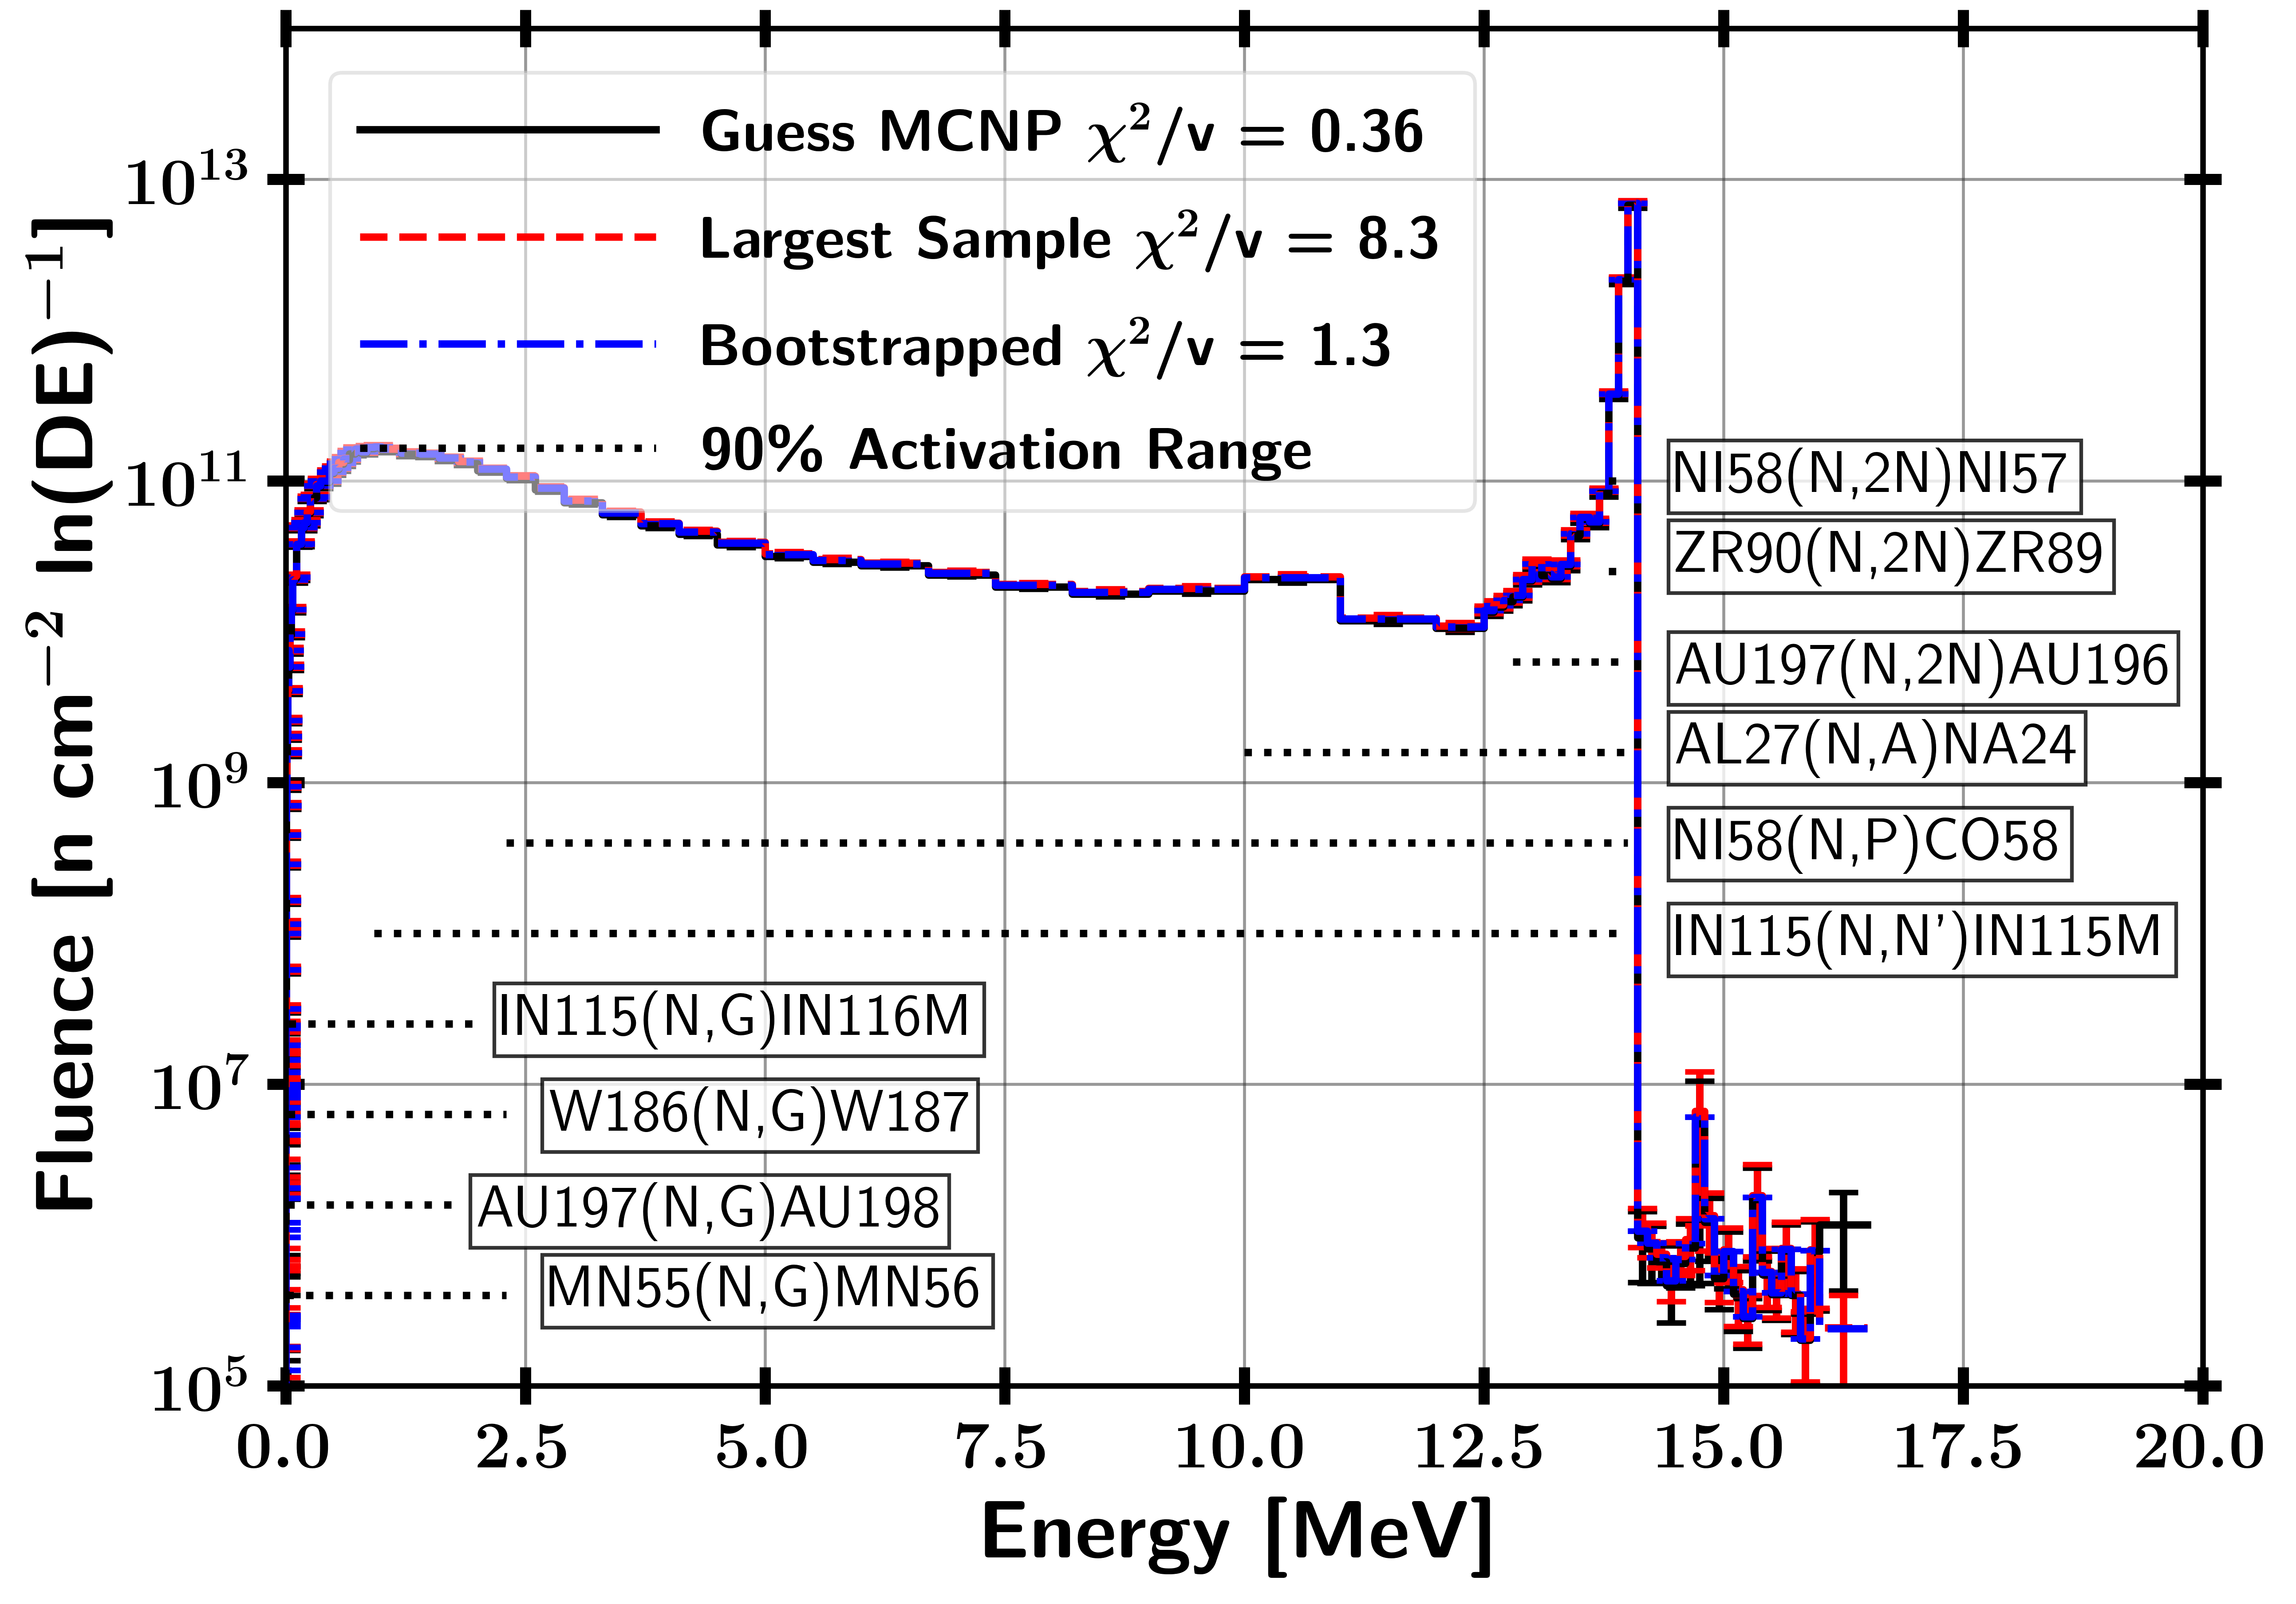
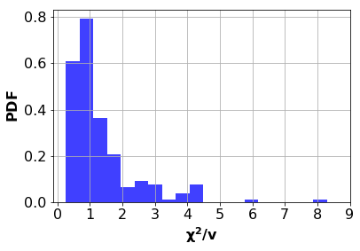
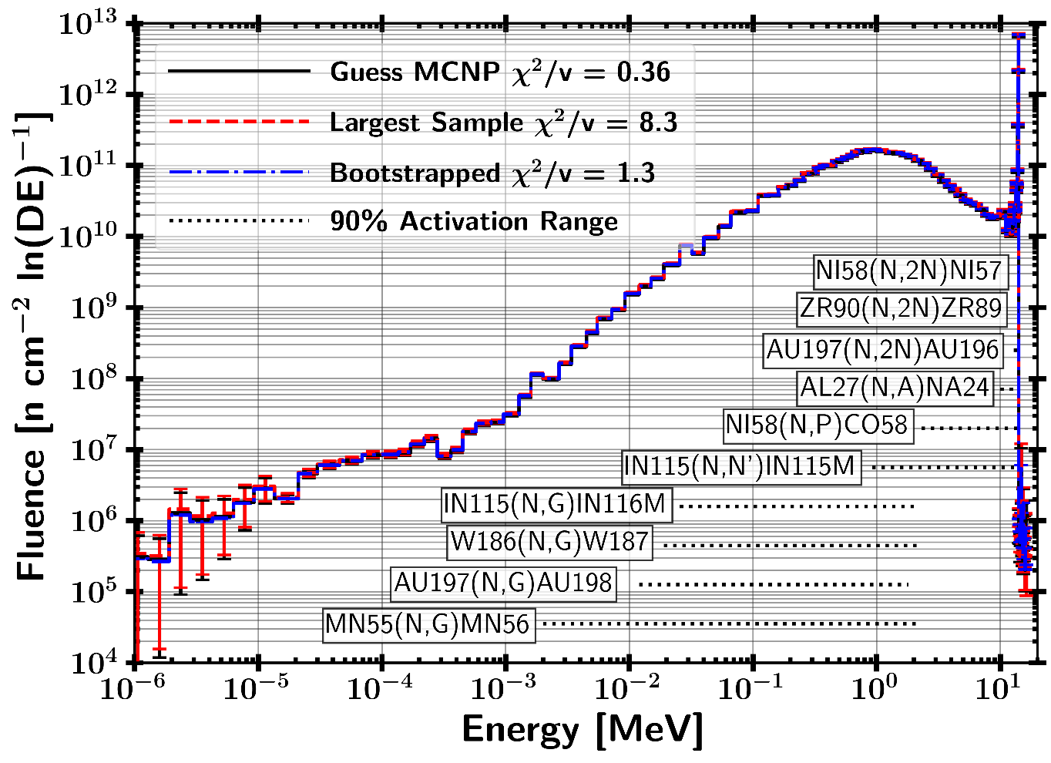
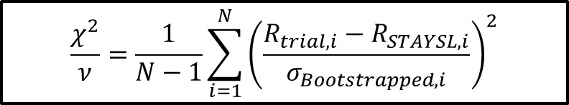
STAYSL Unfolded Spectrum
182 Sampled Activation Results
81.9% of samples were not-rejected with a p-value greater than 0.05
18.1% of samples were rejected with a p-value lower than 0.05
H₀ : Two sets of data are governed by the same expected distribution
$$\frac{χ^{2}}{ν}=\frac{1}{N−1}\sum_{i=1}^{N}{{\left(\frac{R_{trial,i}−R_{STAYSL,i}}{σ_{Bootstrapped,i}}\right)}^{2}}$$

Slide 10
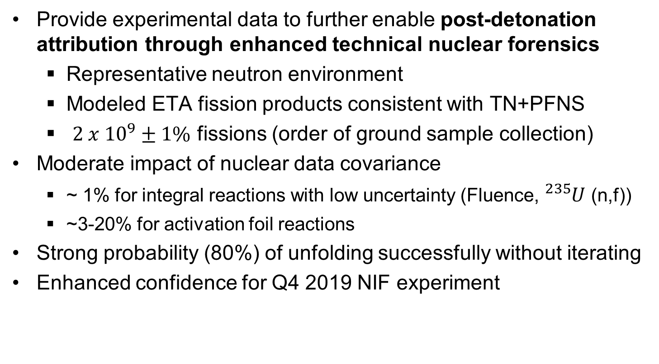
Conclusions
Provide experimental data to further enable post-detonation attribution through enhanced technical nuclear forensics
Representative neutron environment
Modeled ETA fission products consistent with TN+PFNS
$2 x {10}^{9}±1\%$ fissions (order of ground sample collection)
Moderate impact of nuclear data covariance
~ 1% for integral reactions with low uncertainty (Fluence, ${}_{}^{235}U$ (n,f))
~3-20% for activation foil reactions
Strong probability (80%) of unfolding successfully without iterating
Enhanced confidence for Q4 2019 NIF experiment

Slide 11
Backups

Slide 12
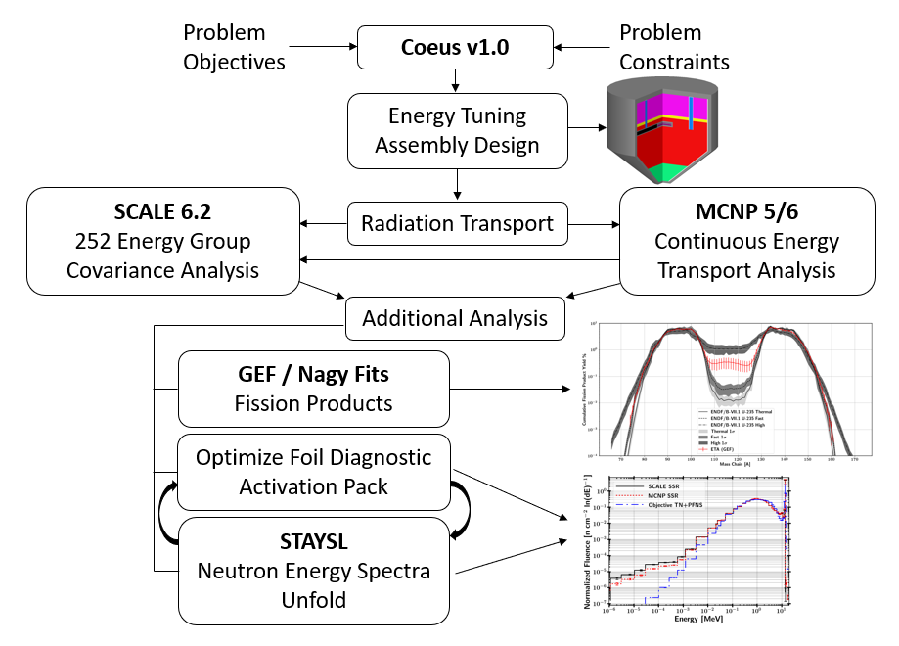
Methodology

Slide 13
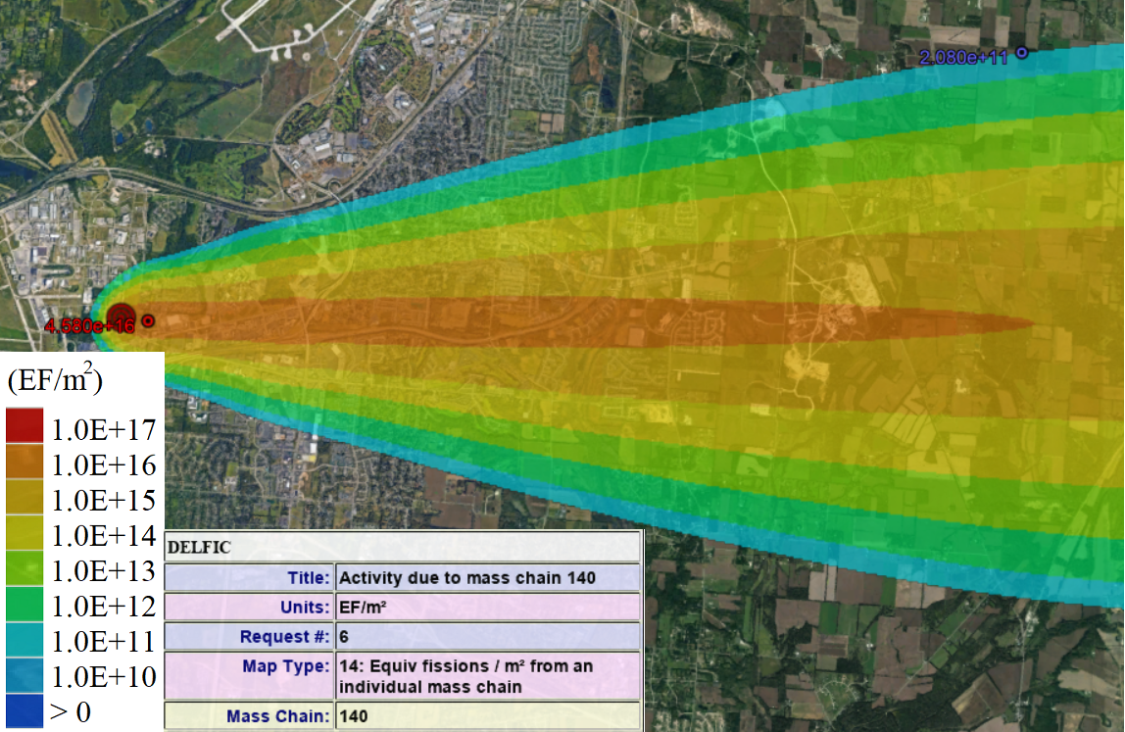
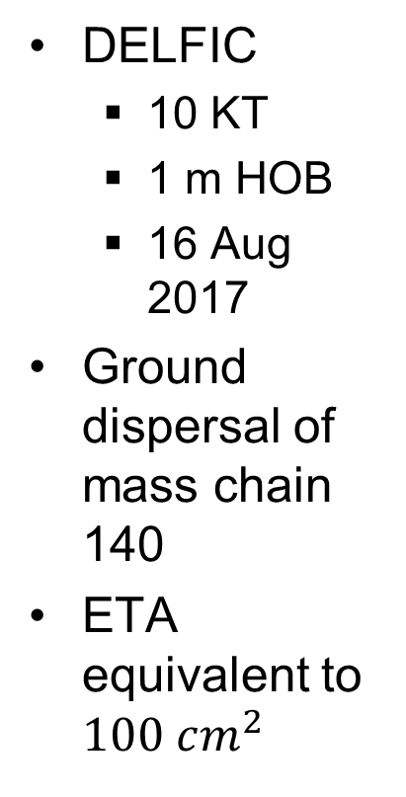
Fission Production Capability Perspective
DELFIC
10 KT
1 m HOB
16 Aug 2017
Ground dispersal of mass chain 140
ETA equivalent to $100 cm^{2}$

Slide 14
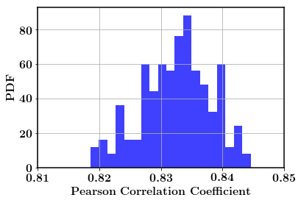
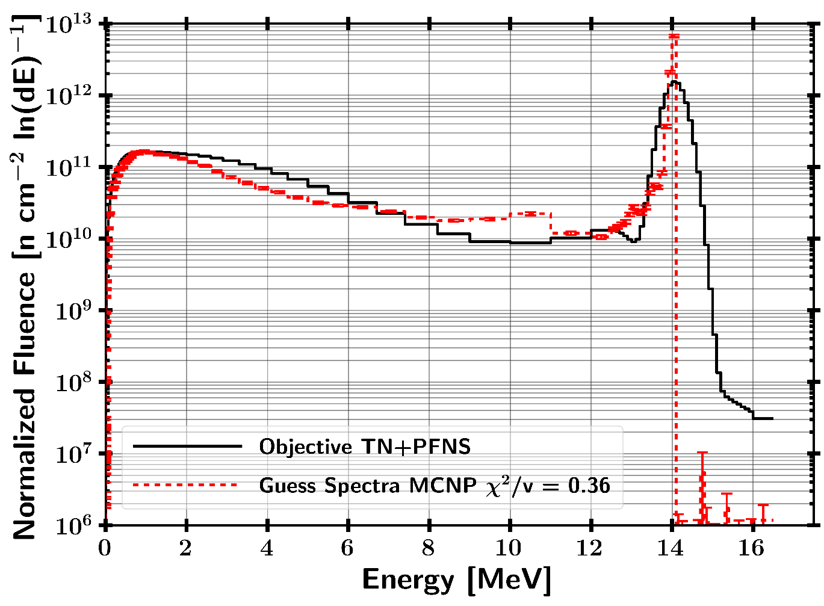
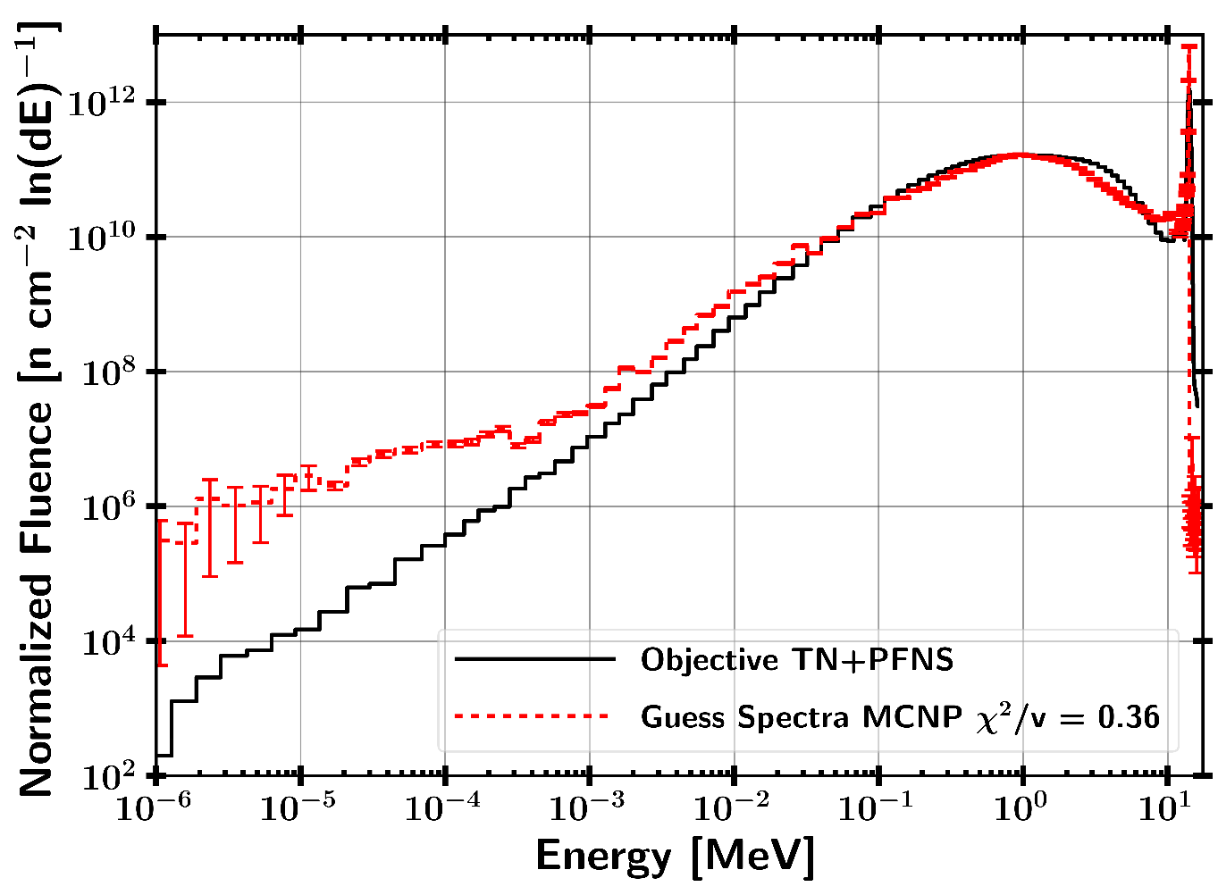
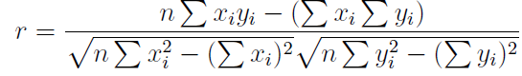
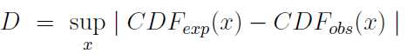
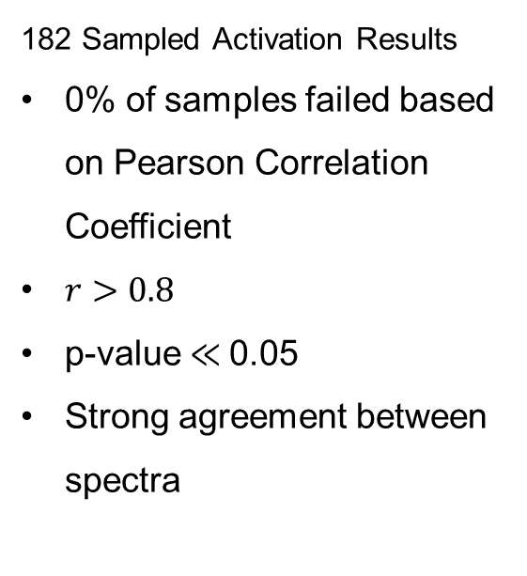
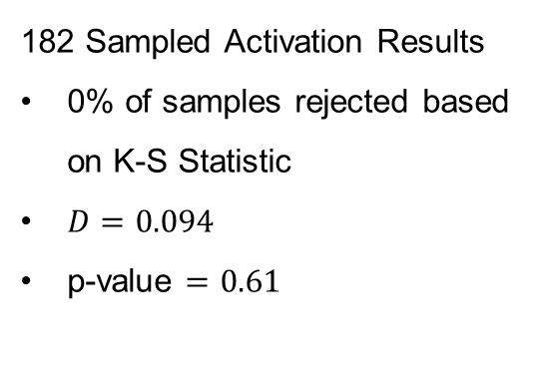
STAYSL Unfolded Spectrum Pearson Correlation Coefficient and K-S Statistic
182 Sampled Activation Results
0% of samples rejected based on K-S Statistic
$D=0.094$
p-value $=0.61$
182 Sampled Activation Results
0% of samples failed based on Pearson Correlation Coefficient
$r>0.8$
p-value $≪$0.05
Strong agreement between spectra
H₀ : The two samples are drawn from the same distribution.
H₀ : There is no correlation between the datasets.
14

